Slide 1
Idle-Free Zone
School Implementation
Presented by: <insert your name and contact information here>

Slide 2
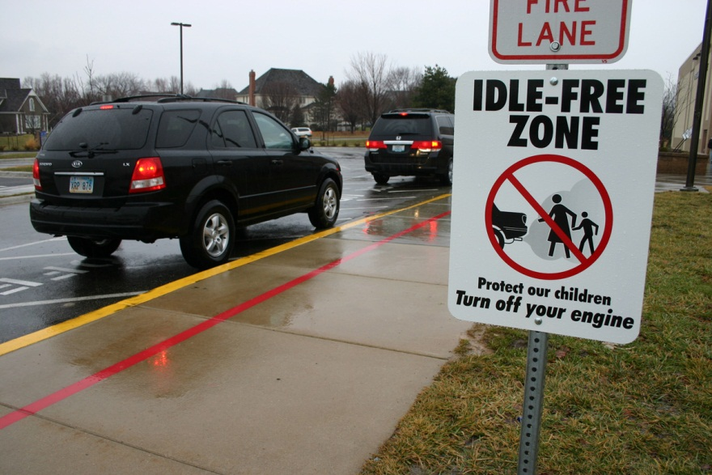
What is idling?
Running the engine when the vehicle isn't moving
Most of the time idling isn't necessary

Slide 3
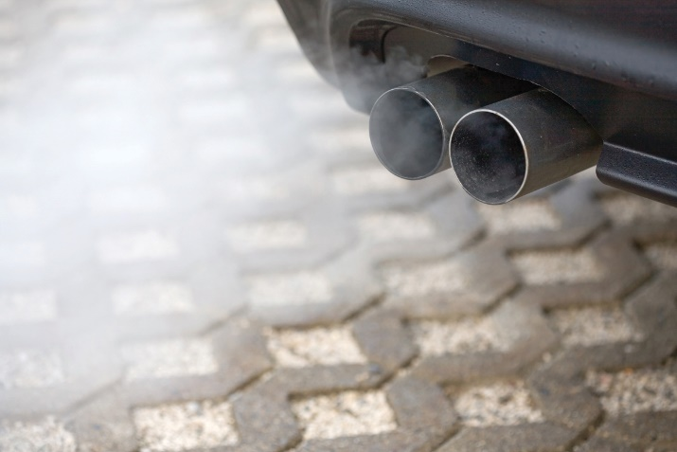
Idling = Pollution Impacts the environment and your health
Contributes to the formation of ground-level ozone pollution, which can cause eye, nose and throat irritation.
Long-term exposure increases the risk of respiratory illnesses, such as allergies, asthma and lung cancer.

Slide 4
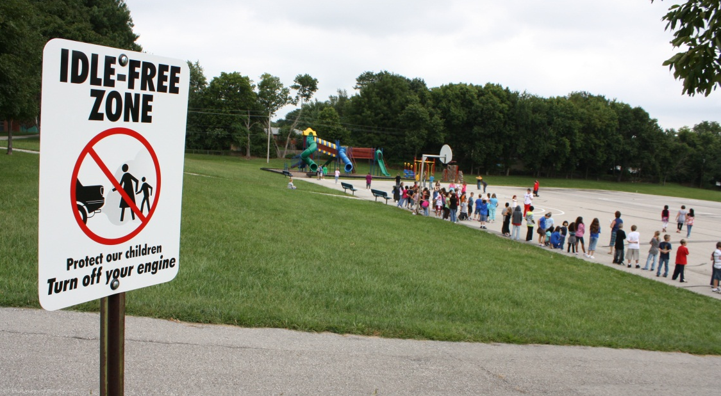
Idling = Pollution Impacts the environment and your health
The chemicals and small particles in vehicle exhaust are known causes of asthma symptoms.

Slide 5
Idling = Pollution Impacts the environment and your health
Children may be more affected because they breathe more air per pound of body weight than adults.
Kids with asthma are absent from school an average of two more days per year than their healthy peers.

Slide 6
Alternatives to Idling
Park your vehicle and walk to meet your kids instead of waiting in line.
Start your engine only when you’re ready to go and turn it off as soon as you arrive.

Slide 7
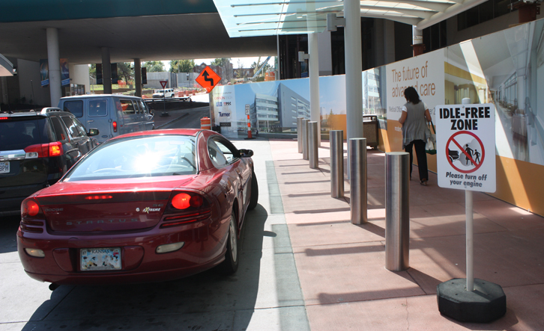
Alternatives to Idling
Bring hot or cold beverages in reusable containers and keep blankets in the car to manage extreme hot and cold weather.
When using a drive-through window, turn your engine off while you’re waiting. Or simply go inside.

Slide 8
Air Quality Learn more about air quality in the region
Mid-America Regional Council Air Quality Program marc.org/airq | 816/474-4240 facebook.com/airqkc twitter.com/airqkc

